Slide 1
Capstone Project
Airbnb Exploratory Data Analysis Submitted by : Kabeer Pande

Slide 2
Introduction
Since 2008, guests and hosts have used Airbnb to expand on traveling possibilities and present a more unique, personalized way of experiencing the world. Today, Airbnb became one of a kind service that is used and recognized by the whole world. Data analysis on millions of listings provided through Airbnb is a crucial factor for the company. These millions of listings generate a lot of data - data that can be analyzed and used for security, business decisions, understanding of customers' and providers' (hosts) behavior and performance on the platform, guiding marketing initiatives, implementation of innovative additional services and much more.

Slide 3
Steps involved
1. Importing the dataset and libraries.
2. Getting an overview of the dataset.
3. Cleaning the data set and getting rid of null values and outliers.
4. Data Analysis
5. Data Visualization
6. Conclusions

Slide 4
Purpose of analysis
The purpose of this analysis is to find out the demand in Airbnbs according to neighbourhood, price etc and make predictions accordingly. Some neighbourhoods are expensive during a particular season, whereas some maintain a high price throughout the year. I analyzed the dataset over pricing, neighbourhood, room type and popularity. I have stated the conclusions further in my presentation.

Slide 5
Problem Statements
What can we learn about different hosts and areas?
What can we learn from predictions? (ex: locations, prices, reviews, etc)
Which hosts are the busiest and why?
Is there any noticeable difference of traffic among different areas and what could be the reason for it?

Slide 6
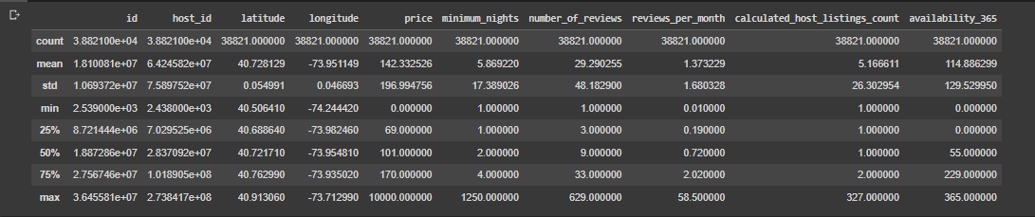
An overview of the dataset

Slide 7
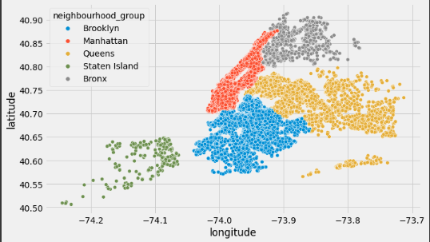
Scatter plot of airbnbs in different neighbourhoods on map
Brooklyn and Manhattan has the maximum number of AirBnbs

Slide 8
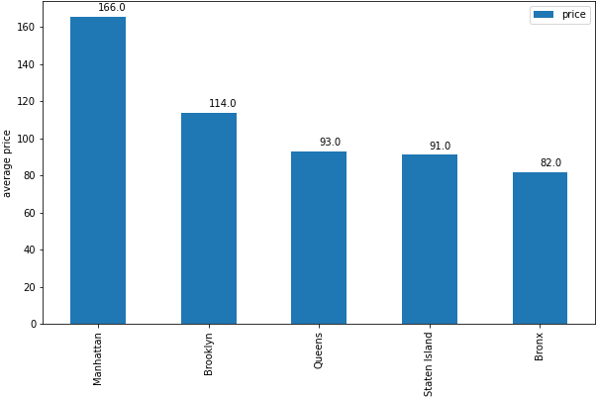
Average price by each neighbourhood
Manhattan has the highest average price. It is double the average price of Bronx

Slide 9
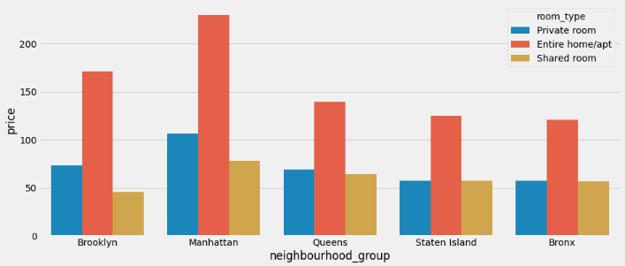
Average price by room type
It is obvious that entire home/apt are more expensive. If you are travelling to Staten Island, Bronx or
Queens, it is better choice to opt private room as the private and shared room have similar prices.

Slide 10
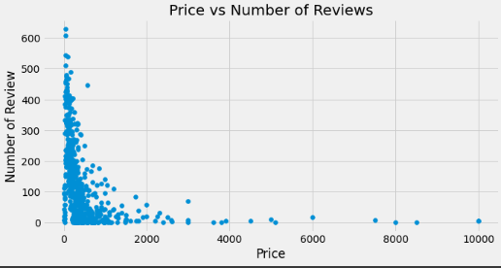
Popularity according to price
Airbnbs with price less than 1000 are most popular. The most expensive airbnb has only a single review.

Slide 11
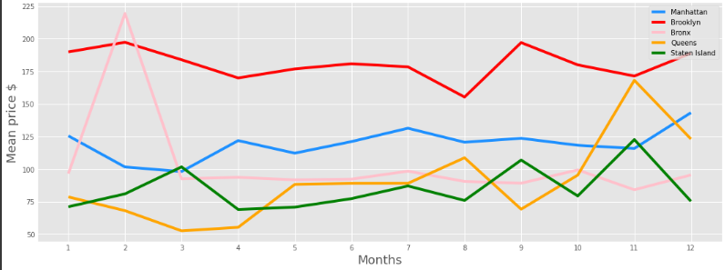
Mean prices of different neighbourhoods through the year
Bronx experiences a surge in price in the month of February. Brooklyn maintains a high price
throughout the year although prices in August are bit cheap. Queens is expensive in the month of November.

Slide 12
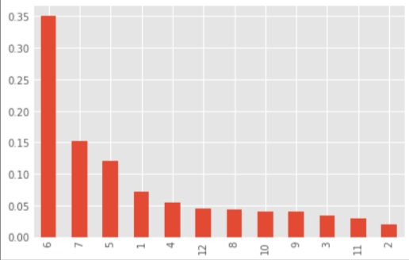
Busiest months
June and July are the busiest months. 35% of the bookings are done in June and 15% bookings are done
in July.

Slide 13
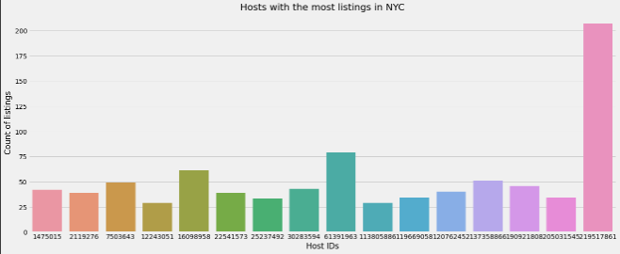
Hosts with most listings in NYC
Host 219517861 has the most listings in NYC.

Slide 14
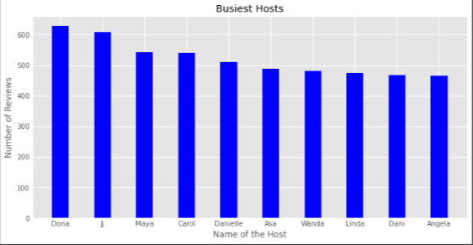
Busiest Hosts
Donna is the busiest host with 600+ reviews followed by J.

Slide 15
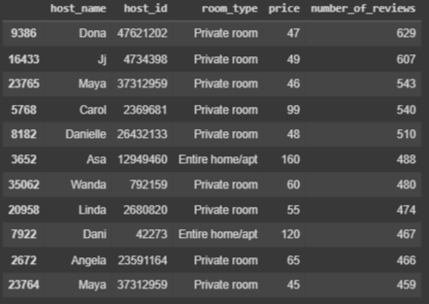
Insight into busiest hosts
On analyzing the table we can notice some similarities. Private rooms are booked most.
Price range is between 45-100 dollars. Therefore we can conclude people prefer private rooms in price
range 45-100.

Slide 16
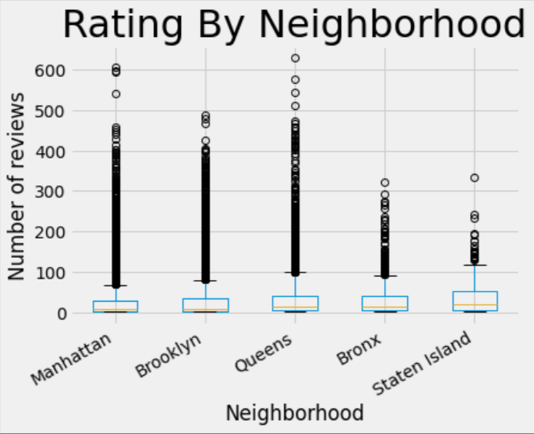
Popularity by neighbourhood
Brooklyn and Manhattan are the busiest neighbourhoods.

Slide 17
Conclusion
Most people spend <400 a night. Therefore cheaper accommodation will have higher demand and traffic.
Bronx sees a big surge in price in the month of February. It might be because of an annual local festivity.
An Airbnb operational only in the month of February can fetch good profits in Bronx.
3. June and July are the busiest months. 35% of the bookings are done in June. Therefore it is highly
advisable to keep the Airbnb available in the month of June and July and stock up on resources before the summer vacations begin.
Private rooms are preferred as compared to other room type. It is better to rent a villa as separate private rooms rather than renting out the entire villa.
Brooklyn and Manhattan are expensive and busy neighbourhoods. One time investment can here reap profits for a long time. But the competition is also high as most number of listings are in Manhattan and Brooklyn.
An Airbnb in Brooklyn or Manhattan with separate private rooms charges <400 operational throughout the year is an ideal airbnb according to the data.

Slide 18
Use Case
Our client is solo traveller who is looking for a peaceful time away from the hustle bustle of the city. He is travelling on a budget so he prefers a cheap neighbourhood. He has planned a week’s trip so the minimum nights has to be seven or less. In addition the user requires a private room because he wants a peaceful and alone time. Client's constraint is his budget which is 500 for a week's trip.

Slide 19
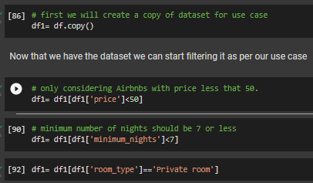
Filtering the dataset according to our use case

Slide 20
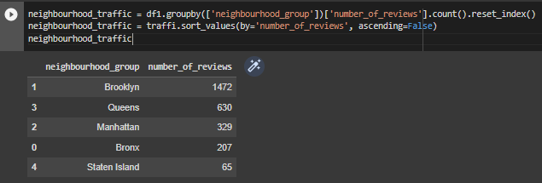
Insight into neighbourhood traffic
Brooklyn has the most number of reviews followed by Queens. But this data does not conform anything
because it is the filtered data.

Slide 21
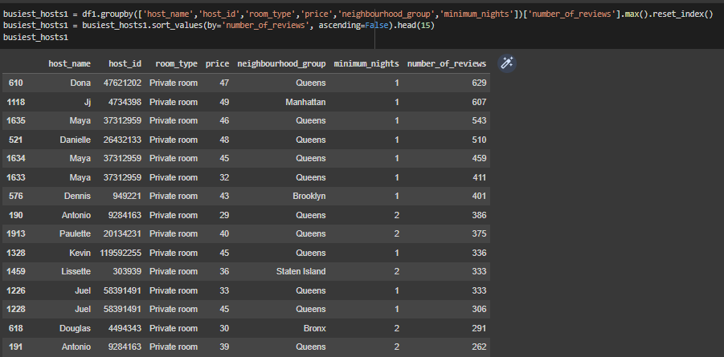
Best hosts with private room type and price< 50
Queens has a lot of top reviewed Airbnbs that fills our client’s criteria.

Slide 22
Conclusion:
A lot of top hosts are from Queens. That means our client can choose from a variety of Airbnbs.
Also availability won't be an issue in Queens because there are a lot of options to choose from.
Only one host from Staten Island is in top 20 busiest hosts.
We will recommend our client to travel to Staten Island only after pre booking the room because it might be hard to get a decent room due to less availability.
Queens has a lot of Airbnbs fitting the client's criteria therefore Queens is the ideal destination for our client.

